Slide 1

TUTORIAL FOR ARDUINO UNO
TITTLE: ARDUINO DISTANCE MEASUREMENT

Slide 2
HOW PROJECT ABOUT?
In each sector, small requirements are essential for the development of major measures, including occurring new normal for today.

Slide 3
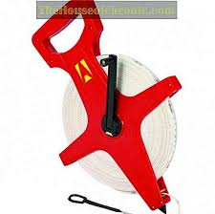
DEVELOPMENT WHEEL MEASUREMENT

Slide 4
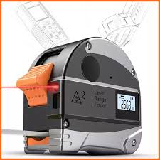
DEVELOPMENT ELECTRONIC MEASUREMENT

Slide 5
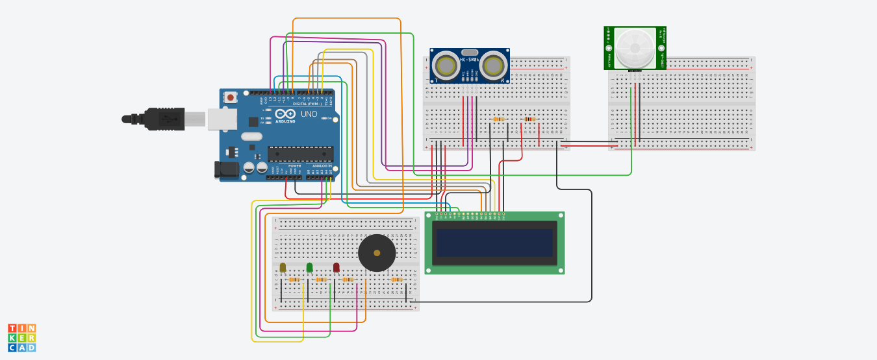
DEVELOPMENT ARDUINO DISTANCE MEASUREMENT

Slide 6
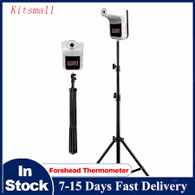
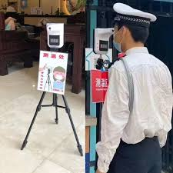
PROPOSED DESIGN

Slide 7
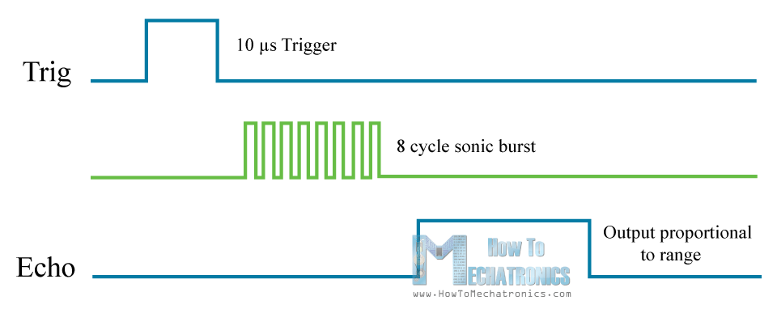
ABOUT ULTRASONIC
Trig setting to HIGH STATE
send out an 8-cycle sonic burst will travel at the speed sound.
Received sound speed

Slide 8

How to calculate?

Slide 9
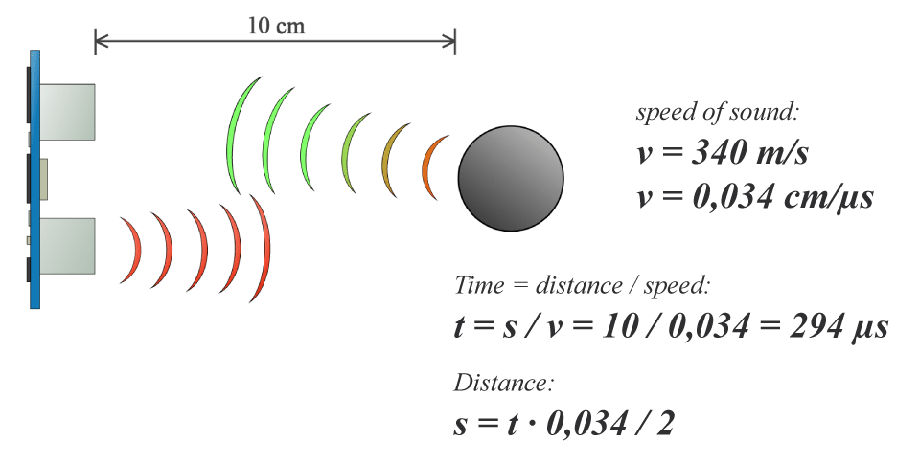
object is 10 cm away from the sensor.
sound wave will need to travel about 294 u seconds.
to get the distance in cm we need to multiply the received travel time value from the echo pin by 0.034 and divide it by 2.

Slide 10
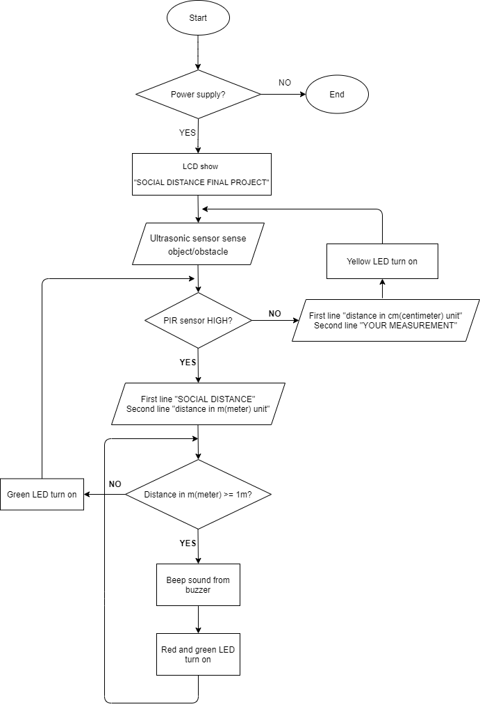
FLOWCHART PROGRAM

Slide 11
TUTORIAL FOR ARDUINO UNO
THANK YOU FOR WATCHING

